Slide 1
SMART SHOPPING CART WITH AUTOMATIC BILLING SYSTEM BASED ON IoT
Everyday, people go grocery shopping and often have a hard time to calculate the price of all items, wait long in queue for payments, and finally struggle to bring the items to their vehicles or carry them back home by hand. This seemingly trivial-yet-taxing matter can be made a lot easier with the help of smart shopping cart with automatic billing system.

Slide 2
HOW IT WORKS
This smart cart can follow user when shopping, whether indoor or outdoor, and connected to their smartphone to automatically calculate total shopping price and manage the payment. To follow the user, the cart’s system uses GPS when outdoor and ultrasonic sensor when indoor. It also equipped with RF-id system which can automatically scan the amount and price of each grocery item in the cart and relay the information to user’s smartphone using IoT system. On the other hand, mobile application system enables the user to get the said information. After shopping, user must make the payment before they can take the items or exit the shopping area, or else the alarm will sound off. The resulted prototype of the smart cart is smaller than normal cart, but the system can work well although the GPS is limited to certain area.

Slide 3
HOW IT WORKS
In this project, we use an Arduino Uno to build an autonomous "follow me". The robot connects to a smartphone via GPS to navigate. All the electronics will be contained in the base so that other objects can be carried as well.
the components including a L298N motor driver, PAM-7Q GPS, and HMC6883L compass were mounted inside and connected to the Arduino through the breadboard.
The compass we connected the SLC and SDA pins to A5 and A4 respectively. The rest of the pins were connected through digital I/O.

Slide 4
COMPONENTS AND SUPPLIES
ARDUINO UNO
GPS MODULE
Accelerometer
BREADBORD
RFID
WIRES

Slide 5
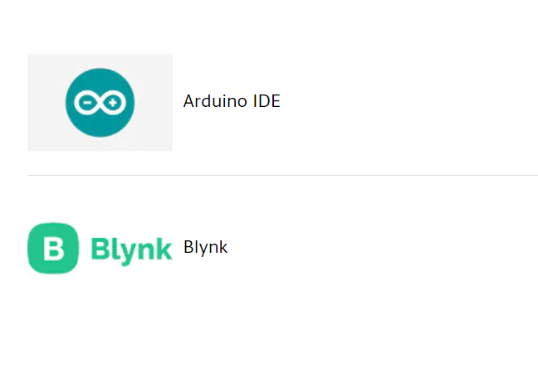
APPS AND ONLINE SERVICES

Slide 6
Measuring Displacement using accelerometer:
Abstract
In order to intelligently measure the displacement of moving objects, a small displacement measuring system based on MEMS (microelectromechanical system) accelerometer is designed.
Introduction
With the development of MEMS technologies, MEMS accelerometers are penetrating more and more high-end applications such as aerial navigation, earthquake detection, and gravity measurement . MEMS accelerometer has the characteristics of small size, light weight, and strong impact resistance.

Slide 7
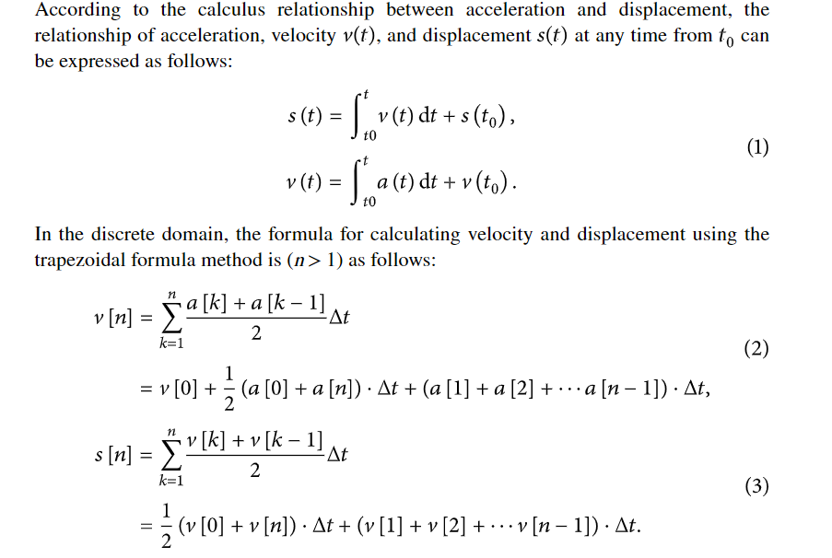
Measuring Displacement:

Slide 8
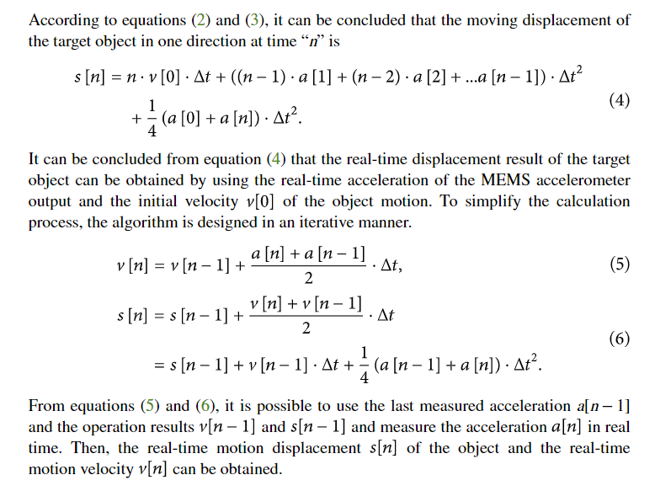

Slide 9
Through simulation experiments, it is found that the system has good antioverload capability, and the displacement measurement average accuracy can reach 0.96%, which has very important engineering significance..

Slide 10
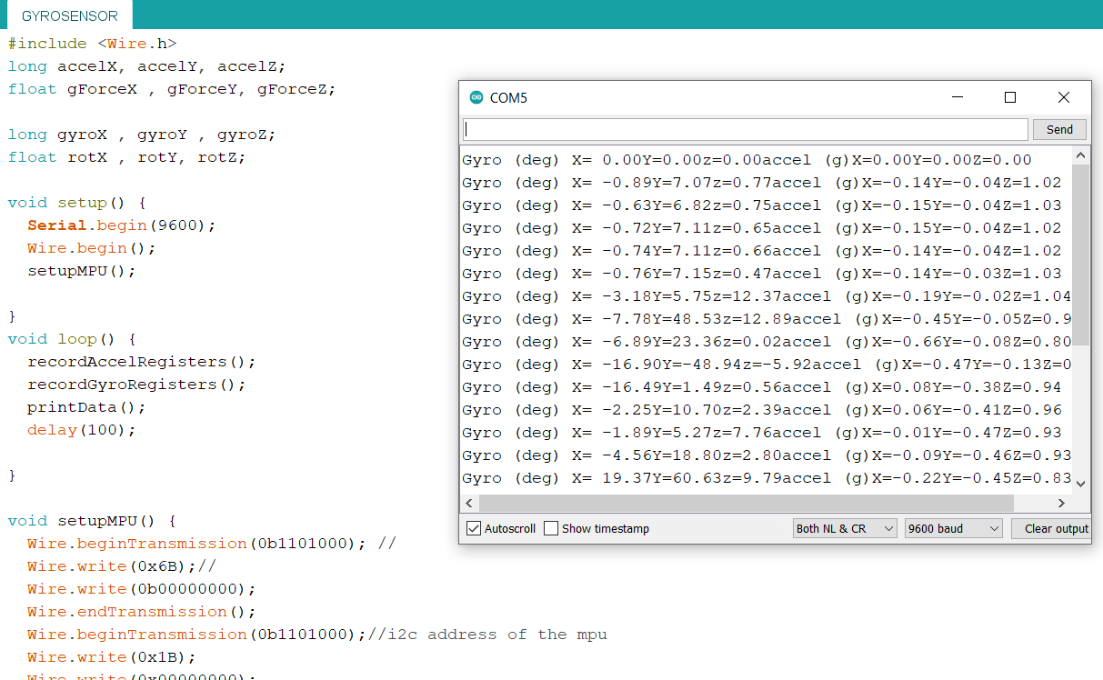
RESULT

Slide 11
VIDEO OF DC MOTOR CONTROL USING X VALUE ONLY :

Slide 12
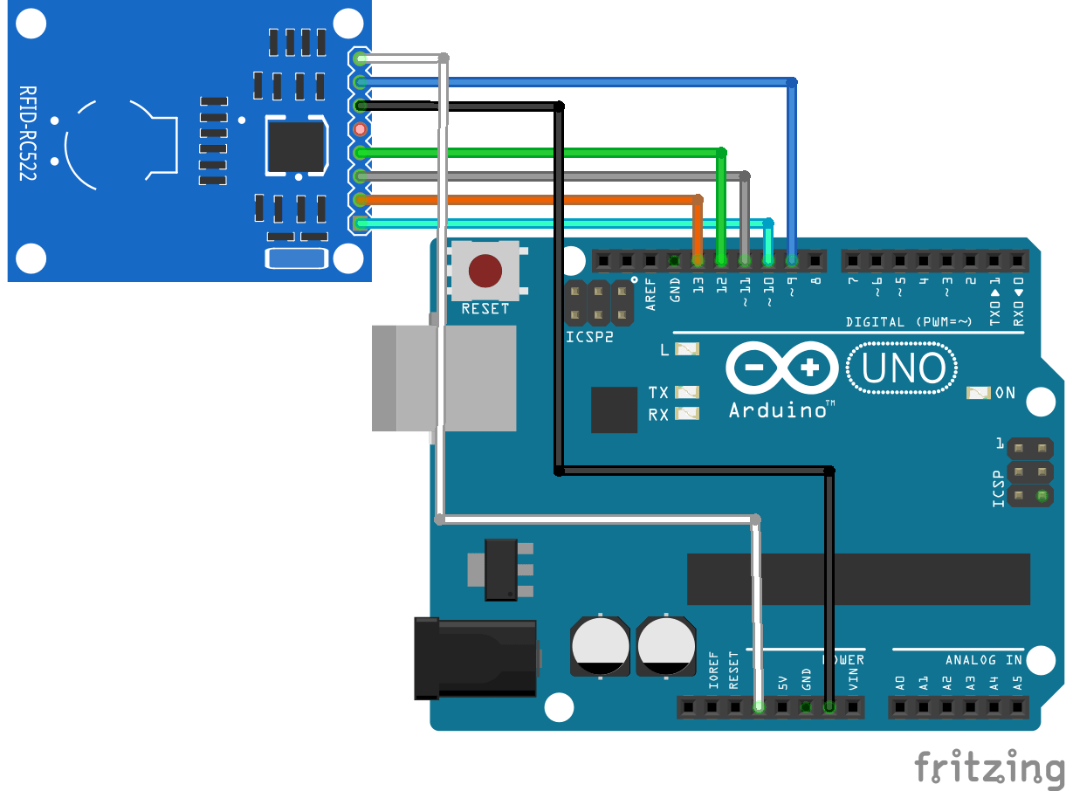
RFID with arduino:

Slide 13
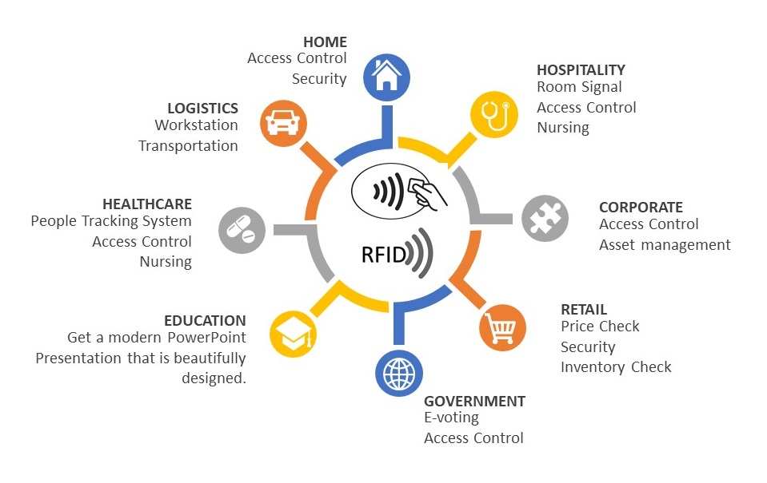
RFID

Slide 14
In this article,we are going to talk about RFID. In our project we will use lots of tag value which we consider as product tag number . The rfid will work as a scanner and all the product will be scanned automatically when the customer will try to put it on the box or trolley.

Slide 15
INTRODUCTION OF RFID :
RFID stands for radio frequency identification and it basically uses the radio waves to read the information on the tag. The RFID tags contains the embedded transmitter and receiver attached to an object.
RFID is fast and does not require any contact between the reader and the tag and they can be read from feet’s away.
An RFID system consists of two parts: Tag and Reader.
An RFID tag contains a chip for storing information about physical object and an antenna to receive and transmit a signal. A RFID tag can usually store 1KB of data but it is enough for storing the name, credit card number, unique identification number, birth date and some more information

Slide 16
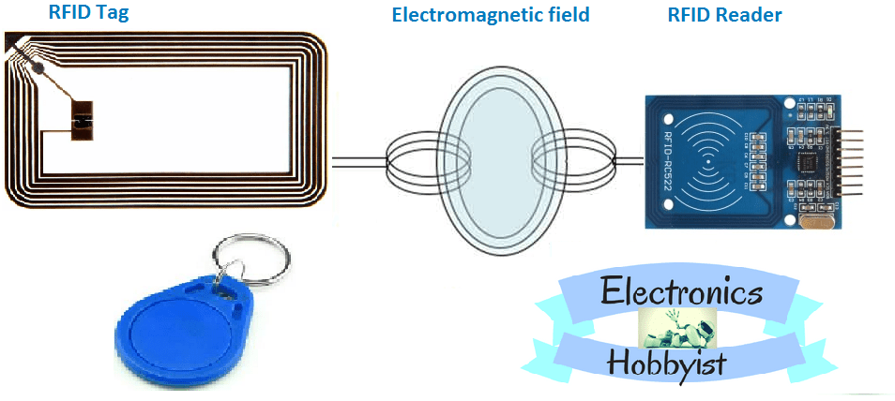
RFID Reader
The RFID reader performs two functions: Transmit and receive. So you can also say it a transceiver. The RFID reader contains an antenna, radio frequency module and a control unit.
How RFID works
The RFID reader generates a high frequency electromagnetic field and when the tag comes near it, a voltage is induced in tags antenna coil due to induction. This induced voltage acts as power for the tag. The tag. in return converts the signal in power and responds to the reader

Slide 17
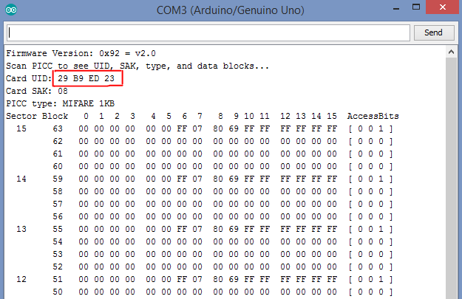
RFID TAG VALUE:

Slide 18
GPS MODULE
What is GPS
The Global Positioning System (GPS) is a satellite-based navigation system made up of at least 24 satellites. GPS works in any weather conditions, anywhere in the world, 24 hours a day, with no subscription fees or setup charges.
How GPS works
Speed
Bearing
Track
Trip dist
Distance to destination

Slide 19
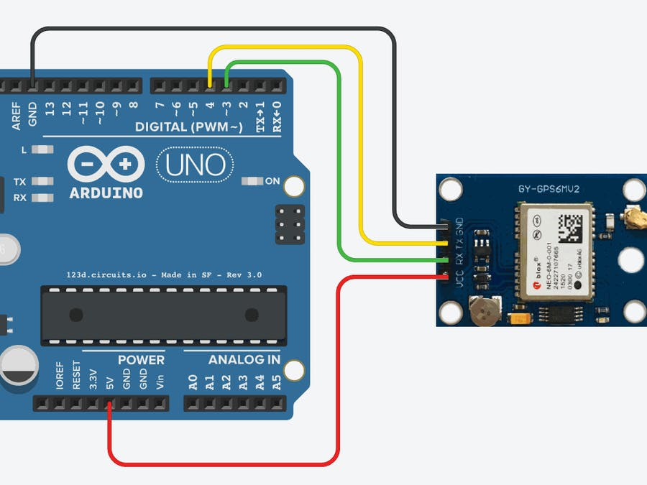
Information about GPS

Slide 20
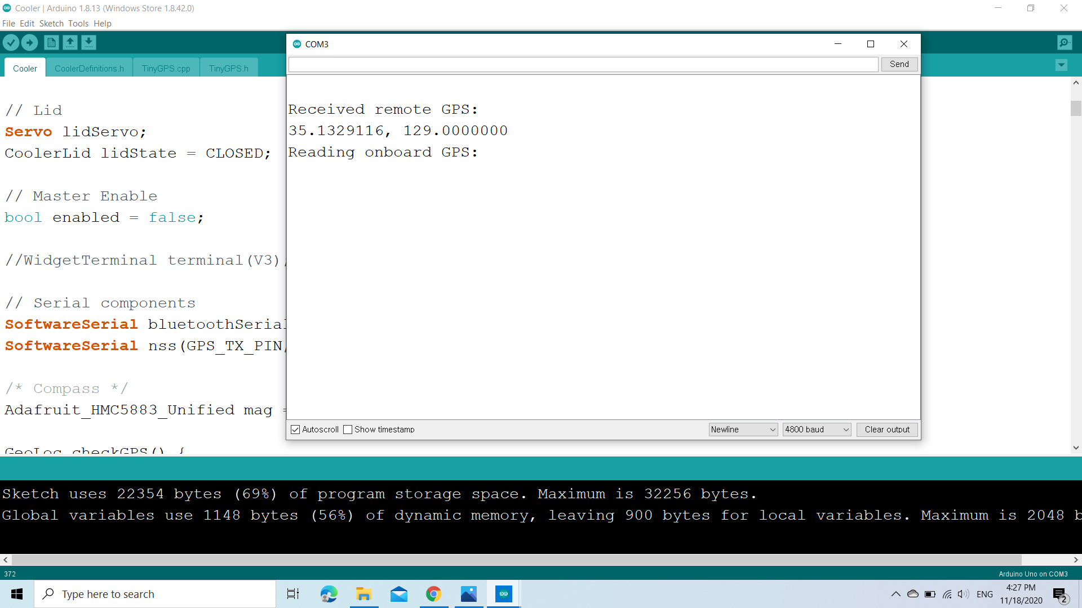
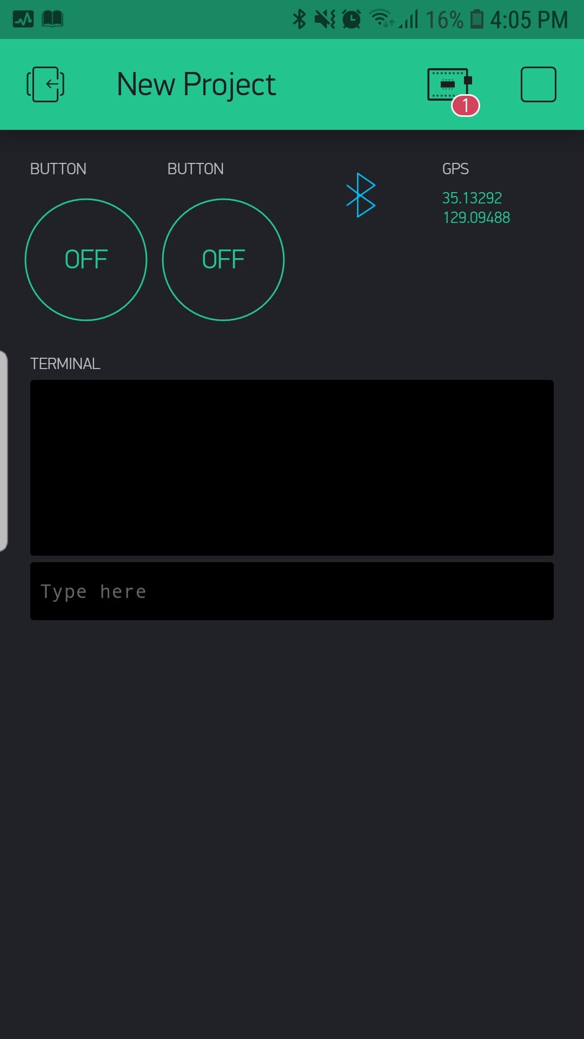
RESULT

